Slide 1
Data Structures & Algorithms Trainer: Laiba Khan, Sheharyar Anwar

Slide 2
Data: Information or values collected and stored in a computer Structure: The way data is organized and stored so that it can be accessed and used efficiently. Algorithm: A step-by-step process to perform a specific task or solve a problem.

Slide 3
Data Structures & Algorithms
DSA is the combination of two concepts: data structures and algorithms.
Data structures are like organized containers for storing information, and algorithms are the step-by-step methods used to perform tasks on that information.

Slide 4
Why Data Structures & Algorithms ?
Efficient Problem Solving: DSA helps in designing solutions that run faster and use fewer resources.
Scalability: Efficient code can handle larger datasets and more complex scenarios.
Foundation for Coding Interviews: Most technical job interviews focus heavily on DSA to assess a candidate's problem-solving abilities.

Slide 5
Real World Example:
Your phone stores contacts as an array, where each contact is an element. If you want to find or access a specific contact, the phone can quickly locate the contact based on its position (index) in the array.
The city map is represented as a graph, where each location is a "node" and each route between locations is an "edge." This helps in organizing and representing the city’s routes.

Slide 6
Types of Data Structures:
Data structures are broadly classified into Primitive and Non-Primitive types.
1. Primitive Data Structures
Basic data types that store single values and are directly supported by the programming language.
2. Non-primitive Data Structures Non-primitive data structures are more complex and can hold multiple values. They are derived from primitive data types and can be used to store large collections of data in structured ways.

Slide 7
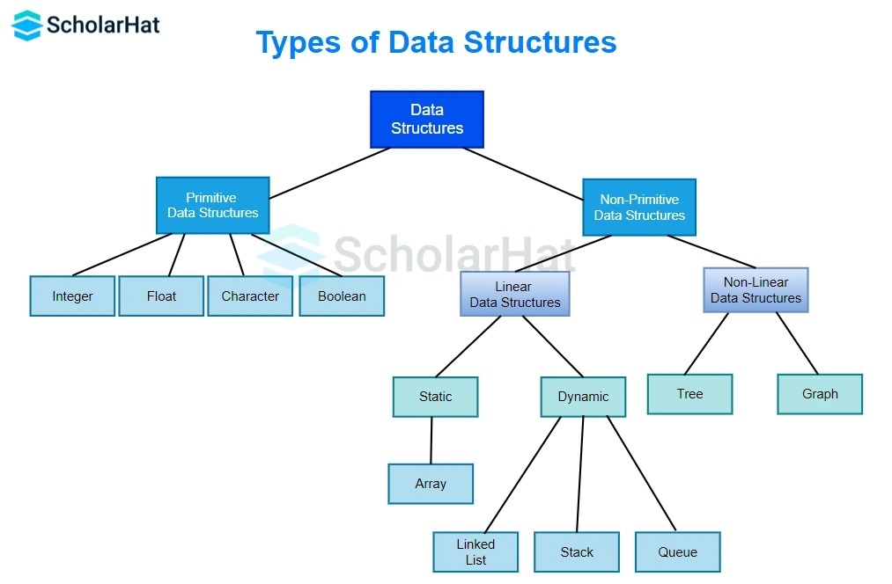

Slide 8
Types of Data Structures:
Data structures are categorized into two main types: Linear and Non-Linear.
1. Linear Data Structures
In linear data structures, data is organized sequentially, one after another. Each element is connected to the next and can be accessed in a single run.
Examples:
Array
Linked List

Slide 9
Types of Data Structures:
2. Non-Linear Data Structures
In non-linear data structures, data is not organized sequentially. These structures allow a hierarchical relationship, with multiple paths to access elements.
Examples:
Trees
Graphs

Slide 10
Common Data Structures:
Arrays
Linked List
Dictionaries\Hashmap
Stack\Queues
Trees
Graphs

Slide 11
Common Data Structure Algorithms:
Linear search
Binary search
Merge sort
Quick sort
Insertion sort
Selection sort
Heap sort

Slide 12
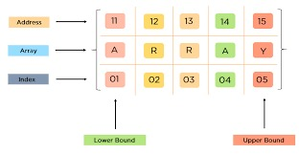
What is an Array?
An array is a collection of elements stored in contiguous memory locations.
Characteristics:
Fixed size (defined at creation)
Homogeneous data type (all elements are of the same type)

Slide 13
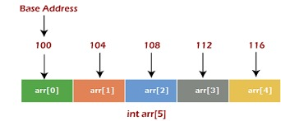
Why we use Array?
To store a large number of elements under a single variable name.

Slide 14
Real World Example
Playlist of Songs
When you create a playlist on a music app like Spotify, the songs are stored in an array. Each song has an index, so you can play them in order or shuffle them easily.
Benefit: The app can efficiently play songs in sequence or jump to a specific song based on its index in the array, keeping everything organized.

Slide 15
Operations of Array
Accessing
Inserting
Deleting
Traversing

Slide 16
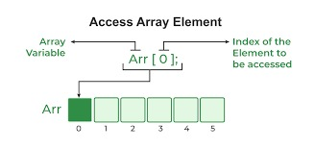
How to access element of an array ?
Every element of an array can be accessed by its index.
Index always starts with 0 and ends with N-1
grades = [85, 90, 78, 92]
print(grades[2])

Slide 17
Inserting Elements in an Array
Inserting involves adding a new element to the array at a specified position.
Example:
Inserting 88 at index 2:
grades = [85, 90, 78, 92] # Current array
grades.insert(2, 88)
#Ouput = [85,90,88,78,92]

Slide 18
Deleting Elements in an Array
Deleting involves removing an element from the array at a specified position.
Example:
Deleting the element at index 2
grades = [85, 90, 78, 92]
del grades[2]
# After deletion
Result: [85, 90, 92]

Slide 19
Traversing Elements in an Array
Traversing refers to visiting each element in the array sequentially.
Example:
grades = [85, 90, 78, 92]
for grade in grades:
print(grade)
Result: 85
90
78
92

Slide 20
Advantages of Array
Fast Access:
O(1) time complexity for accessing elements using an index.
Memory Efficiency:
Contiguous memory allocation can lead to better cache performance.
Simplicity:
Easy to implement and use.

Slide 21
Disadvantages of Array
Fast Access:
O(1) time complexity for accessing elements using an index.
Memory Efficiency:
Contiguous memory allocation can lead to better cache performance.
Simplicity:
Easy to implement and use.

Slide 22
Any Questions?

Slide 23
Thanks!
Do you have any questions?
Itslaibakhan@gmail.com
+92 322 9343785
https://www.linkedin.com/in/laiba-khan-325ba623a/

